Slide 1
Graphical User Interface
You will be used to using programs that have a graphical user interface (GUI).
So far you have been writing programs that have a command line interface (CLI).
Now you are going to learn how to develop programs with a GUI using Python.
Python uses a library or ‘add-on’ called Tkinter to create GUIs.

Slide 2
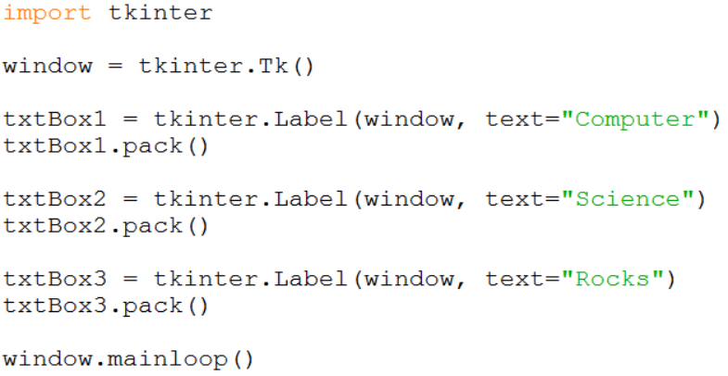
Task 1
Start a new Python program and enter the code shown below:
Creates a new text box containing the text “Computer”.
Add the text box to the screen.

Slide 3
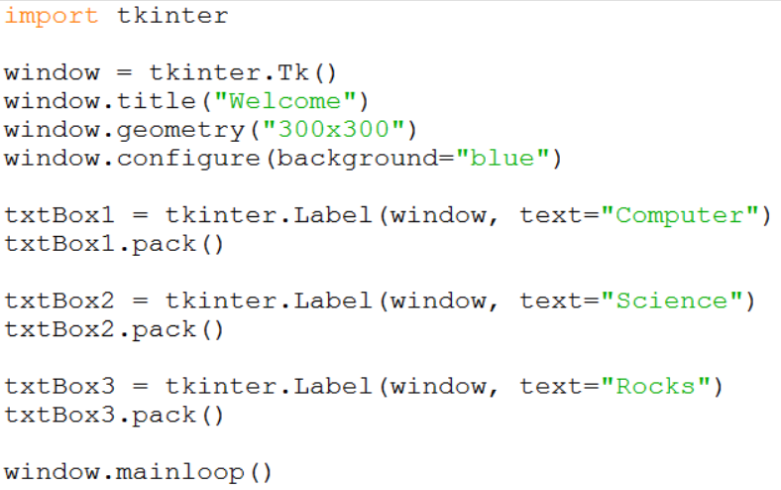
Task 2
Add these three lines of code to your program.
What do the new lines do?

Slide 4
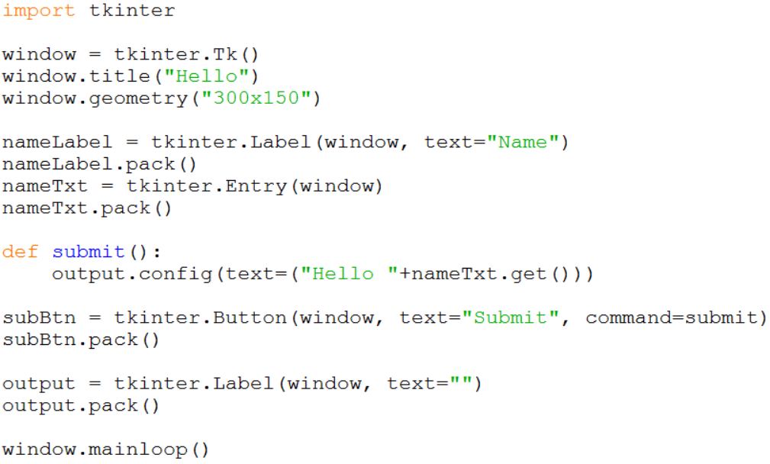
Task 3
Start a new Python program and enter the code shown below:
Adds a text entry box to the screen.
This function is called when the button is pressed.
Adds a button to the screen.

Slide 5
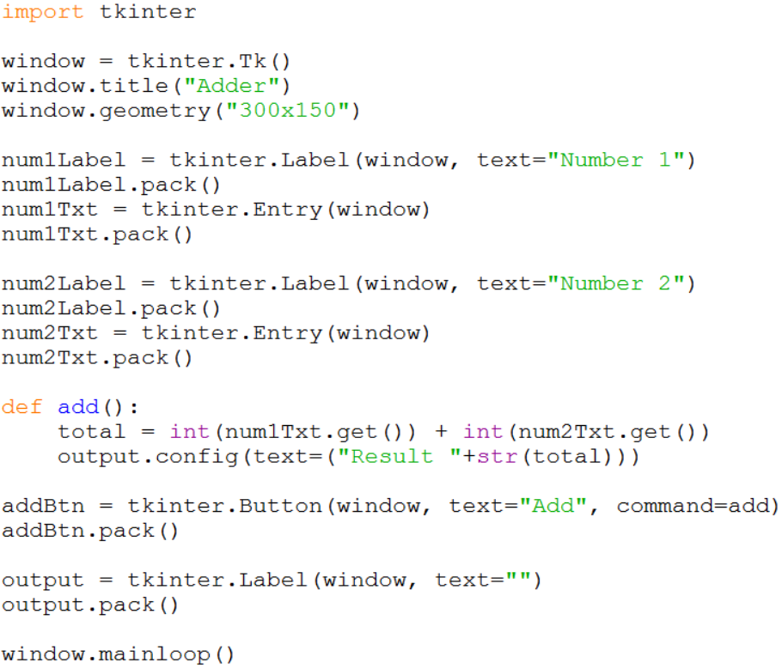
Task 4
Start a new Python program and enter the code shown below:
The inputted numbers are converted to integers for the calculation.

