Slide 1
House Styles

Slide 2
What is a house style?
A house style is a set of rules that set out how all publications created by an organisation should look.
Adam Jones
uPhone Ltd
197 Euston Road
London
NW1 4BH
Adam Jones
uPhone Ltd
197 Euston Road
London
NW1 4BH
Font
Graphics
Colour

Slide 3
Why have a house style?
To ensure customers have a consistent experience.
To make it easy for customers to recognise which organisation created the publication.
To make publications look more professional.

Slide 4
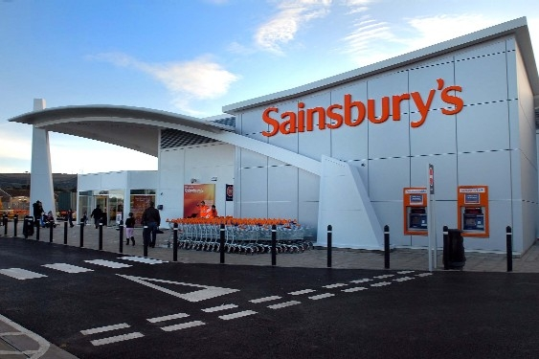
Example

